Slide 1
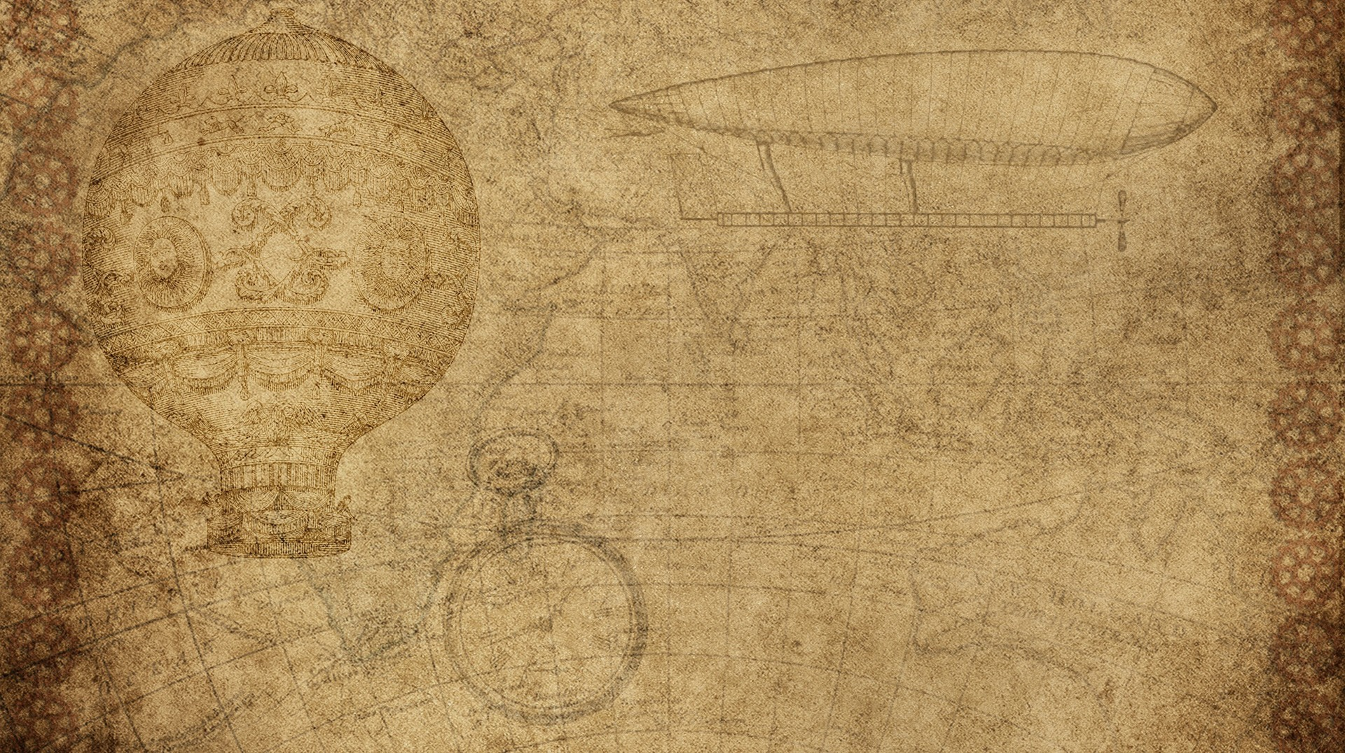

14 - RASC-AL Proposal Requirements & Best Practices
Rudy Cera Jr.

Slide 2

Scoring Criteria & Evaluation Matrix
RASC-AL proposals are scored on:
  Innovation & technical merit
  Mission alignment (theme requirements)
  Realism in technical assumptions & cost
  Systems integration & trade study analysis
Phase 1 and Phase 2 have different weighting:
  Phase 1: Proposal depth, novelty, research
  Phase 2: Technical paper quality, oral presentation, demonstration
Judges expect documented requirements, quantified performance, and credible technology readiness assessments

Slide 3

What Makes a Proposal Stand Out
Winning submissions showcase:
  Clear problem definition tied to mission needs
  Novel solutions with specific technical advances
  Quantified metrics/performance targets
  Systems-level thinking—designs solve multiple challenges
Standouts also present strong trade studies and consistent, unified messaging across all materials.

Slide 4

Common Mistakes to Avoid
Lack of preliminary engineering analysis or quantitative support
Vague tech assumptions—not quoting Technology Readiness Levels (TRLs) or development pathways
Unrealistic or unexplained budget/schedule estimates
Weak trade study documentation (not comparing alternatives)
Inconsistent storytelling between proposal, paper, prototype, and presentation.

Slide 5

Best Practices for Papers, Budgets & Demonstrations
Technical papers: Brief intro/needs statement, requirements flow-down, design details, trade study, tech assessment, cost & risk analysis
Budgets: Use detailed breakdowns (WBS), real labor rates, cost/schedule contingency (10–25% margins), tech maturity costs
Demonstrations & Presentations:
  Prototypes show key risk reduction, align with written design
  Use visuals, teamwork, focused Q&A responses, refer to technical details during forum

Slide 6
Key takeaways
Summary of Key Takeaways for Project HERMES
Theme 1: Communications, Position, Navigation, and Timing (CPNT) Architectures for Mars Surface Operations, our proposal should:
Clearly define CPNT requirements for Mars surface operations (latency, accuracy, coverage, redundancy) and trace all design choices back to these requirements.
Identify genuine technical innovations: Rather than simply proposing standard Earth-based communication networks scaled to Mars, propose novel approaches (e.g., innovative relay architectures, autonomous repair systems, AI-optimized routing, biological or novel material innovations).
Conduct thorough trade studies on architectural alternatives, quantifying performance, cost, and schedule differences.
Integrate data acquisition and tracking as a core design feature—not an afterthought. Show how our CPNT system collects, validates, and processes positioning and timing data in real-time.
Include realistic budgets and schedules with detailed WBS breakdowns and learning curve assumptions.
Identify and mitigate top risks explicitly, showing contingency planning for communication failures or timing disruptions.
Demonstrate team collaboration during the forum with consistent messaging, all members speaking, and confident responses to technical questions.
The winning proposals at RASC-AL consistently demonstrate that innovation + rigor + realism + clear communication = success.

Slide 7
References
Competition Sciences. (2025, August 12). 2026 NASA RASC-AL Competition. https://www.competitionsciences.org/competitions/rascal/
Iowa State University Make to Innovate. (2025, September 23). RASC-AL. https://m2i.aere.iastate.edu/rasc-al/
Lunar and Planetary Institute. (n.d.). RASC-AL. https://www.lpi.usra.edu/lpi/contribution_docs/LPI-001152.pdf
National Aeronautics and Space Administration. (2024, October 29). Students develop innovative lunar exploration concepts in NASA's Artemis competition. https://www.nasa.gov/centers-and-facilities/langley/students-develop-innovative-lunar-exploration-concepts-in-nasas-artemis-competition/
National Aeronautics and Space Administration. (2024, June 12). NASA's RASC-AL Competition selects 2024 winners. https://www.nasa.gov/centers-and-facilities/langley/nasas-rasc-al-competition-selects-2024-winners/
National Aeronautics and Space Administration. (2025, July 1). Auburn team wins 2025 NASA moon and mars design competition. https://www.nasa.gov/directorates/esdmd/auburn-team-wins-2025-nasa-moon-and-mars-design-competition/
National Aeronautics and Space Administration. (2025, August 28). The NASA RASC-AL 2026 competition. https://www.nasa.gov/directorates/stmd/prizes-challenges-crowdsourcing-program/center-of-excellence-for-collaborative-innovation-coeci/the-nasa-rasc-al-2026-competition/
National Aeronautics and Space Administration. (2024, December 31). NASA EXPRESS – Your STEM connection for Sept. 25, 2025. https://myemail.constantcontact.com/NASA-EXPRESS----Your-STEM-Connection-for-Sept--25--2025.html?soid=1131598650811&aid=zBocBvE2s3A
National Aeronautics and Space Administration Goddard Space Flight Center. (n.d.). NAII 1450.3, Guidelines and standards for NASA letters and memoranda. https://nodis3.gsfc.nasa.gov/OPD_Docs/NAII_1450.3_.pdf
NASA Technical Reports Server. (n.d.). Interim report - Design, cost, and performance analyses. https://ntrs.nasa.gov/api/citations/20110015353/downloads/20110015353.pdf
NASA Technical Reports Server. (n.d.). NASA systems engineering processes and requirements. https://nodis3.gsfc.nasa.gov/OPD_docs/NID_7123_69_.pdf
NASA Standards. (2017, July 7). Technical documentation style guide. https://standards.nasa.gov/sites/default/files/standards/KSC/F/0/ksc-df-107_rev_f_07082017.pdf
National Science Foundation. (2021, December 31). Chapter II: Proposal preparation instructions. https://www.nsf.gov/policies/pappg/23-1/ch-2-proposal-preparation
NUSTARS. (n.d.). 2026 RASC-AL. https://nustars.org/2026-rasc-al
Scribd. (2025, October 30). 2025 RASC AL competition guidelines [PDF]. https://www.scribd.com/document/786987507/2025-RASC-AL-Competition-Guidelines
Stellar Solutions. (2019, October 24). IAC-19-E1.5.3.x50835-RASCAL. https://www.stellarsolutions.com/wp-content/uploads/2019/10/IAC-19-E1.5.3.x50835-RASCAL.pdf
University of Maryland. (2015, June 25). UMD students win 2015 RASCAL competition. https://eng.umd.edu/news/story/umd-students-win-2015-rascal-competition
Virginia Tech News. (2024, June 24). Virginia Tech student design team takes top honors at NASA RASC. https://news.vt.edu/articles/2024/06/eng-aoe-nasa-rascal-draupnir.html
YouTube. (2024, March 7). 2024 RASC-AL proposal – South Dakota State University: POSEID-N. https://www.youtube.com/watch?v=1KsaPWpDJow
YouTube. (2025, September 28). Phase 2 tutorial: Prototype solution submission template. https://www.youtube.com/watch?v=AKN6iS5Bw-A

Slide 8
Thank you
Rudy Cera jr.

